Slide 1


Getting Net Zero Right in Policy and Standards
Kaya Axelsson
Policy Engagement Fellow
Oxford Net Zero, Smith School for Enterprise and The Environment
September 2023

Slide 2


Key Contributions
IPCC Special Report that coined Net Zero
About Oxford Net Zero
UN’s High Level Expert Group on Net Zero
Mission:
To inform effective and ambitious climate action among those setting net zero targets in institutions and governments across the globe.
ISO Net Zero guidelines
Oxford Offsetting Principles
Net Zero tracker

Slide 3

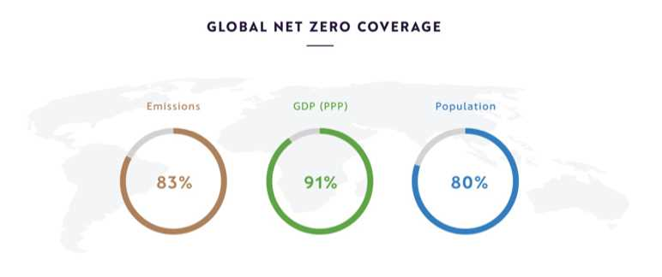
The Story of Net Zero
A new rhetoric of decarbonisation

Slide 4

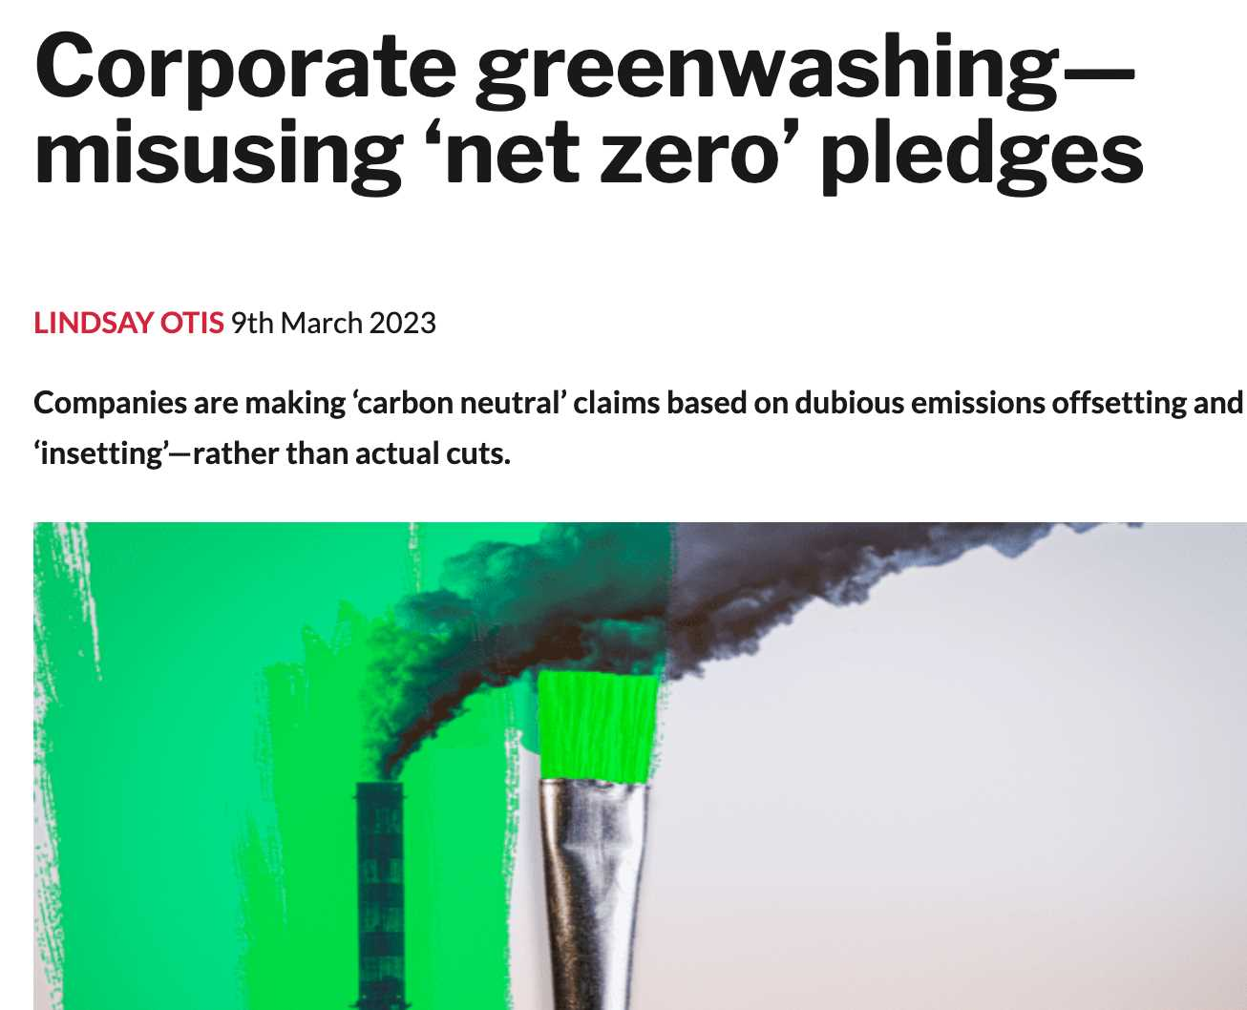


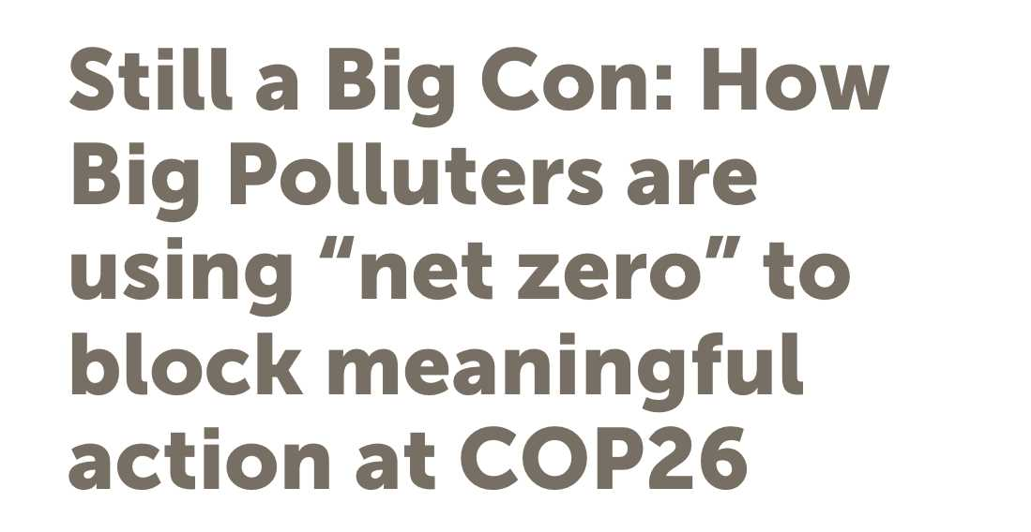

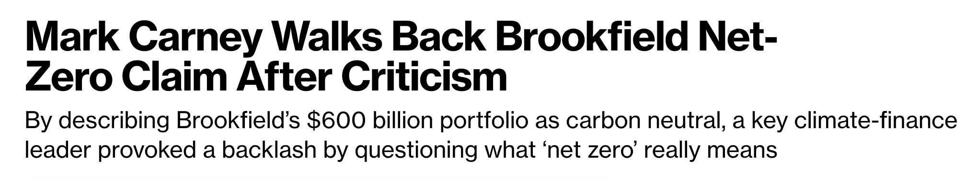
“A surplus of confusion and a deficit of credibility.”

Slide 5

Simple acronym to SCORE
net zero strategies
Short term term plans & targets
Coverage across GHGs scopes
Offsetting scarcely with conditions
Reporting and accountability
Equity for workers, communities & global impacts

Slide 6






New Standards to Improve Credibility
International Standards Organisation’s International Workshop Agreement (ISO)
UN’s High Level Expert Group Net Zero Report (HLEG)
UNFCCC’s Race to Zero Campaign Criteria
Science-Based Target Initiative’s Net Zero Standard
Notes:
ISO: More than 1,200 experts from over 100 countries contributed to make an effective common reference for net zero guidance.
HLEG: UN’s High Level Expert Group Net Zero Report
Recommendations to ensure integrity of net zero commitments by businesses, financial Institutions, cities and regions
Group of 18 diverse experts with expertise in preventing greenwashing

Slide 7
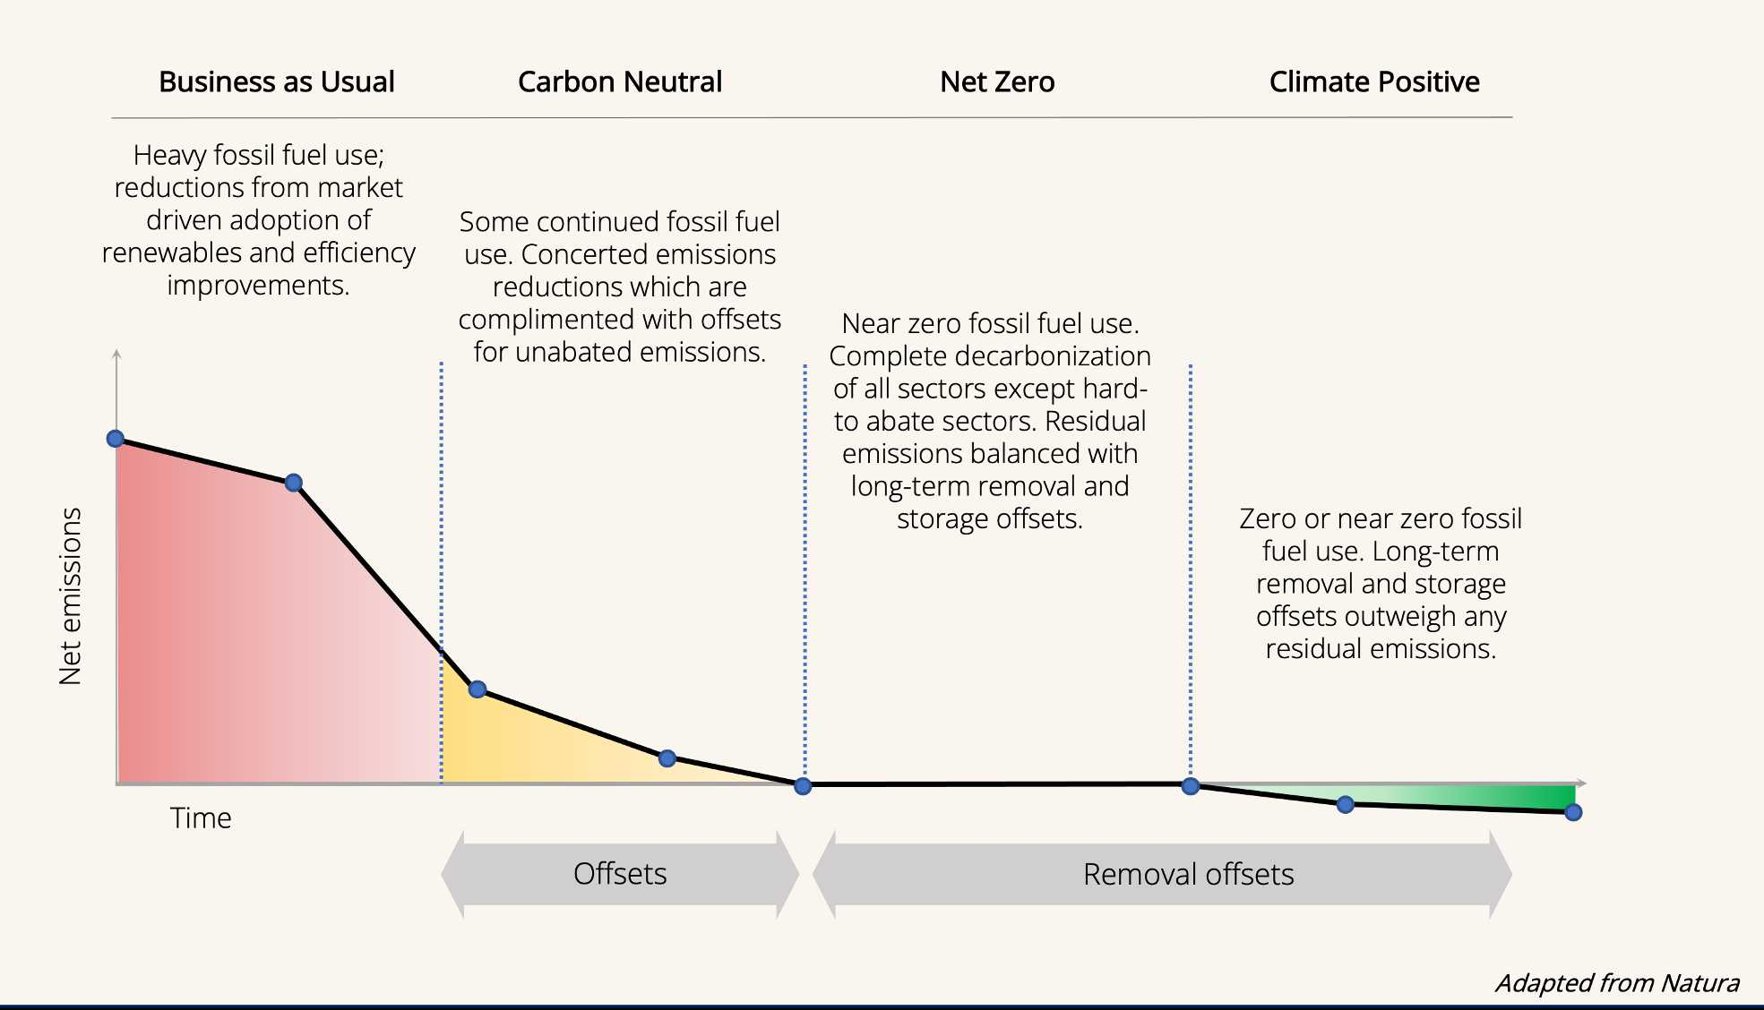
Disentangling Terms
Notes:
ISO: More than 1,200 experts from over 100 countries contributed to make an effective common reference for net zero guidance.
HLEG: UN’s High Level Expert Group Net Zero Report
Recommendations to ensure integrity of net zero commitments by businesses, financial Institutions, cities and regions
Group of 18 diverse experts with expertise in preventing greenwashing

Slide 8
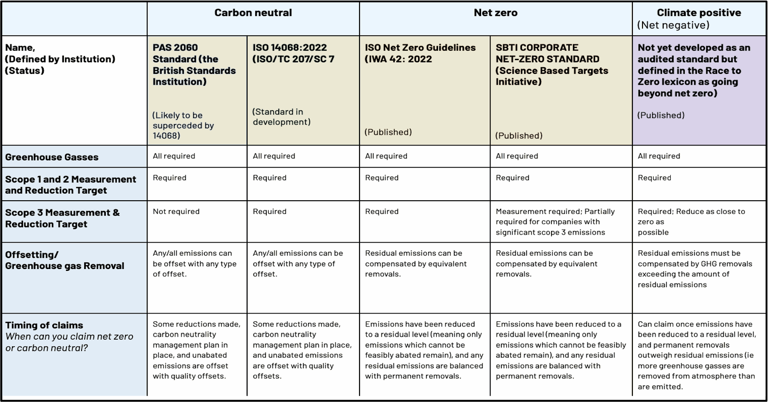
Carbon Neutral vs Net Zero

Slide 9

Net Zero Epochs / Role of ONZ
START
2008-2015
Concept-development phase
Scientists advocate for net zero - Myles Allen
2015-2021
Target-setting phase
Developed tracker for accountability on quality of targets
2021-2022
Guidance-Development Phase
Contributed to HLEG & ISO standards
2023-2025
Guidance Adoption Advocacy Phase
Advocate for policy and private sector adoption
of standards
2025-2050
Implementation phase
Continue to drive adoption of guidance &
advise on implementation
2050-
  Net zero achieved and maintained
GOAL
Notes:
Oxford Net Zero has been engaged in the Net Zero space since its inception, with our Director Dr. Myles Allen, David Frame and other scientists publish a paper in 2009 showing that global warming is determined by CUMULATIVE emissions and that temperatures do not decline for many centuries after a complete cessation of CO2 emissions. Therefore birthing the frame of “net zero”
Some relevant reading: Net Zero: Science, Origins and Implications

Slide 10
Timeline of Net Zero
2015
Paris Agreement prescribes reaching a balance between emissions and removals in second half of this century.
2009
2018
Scientists conclude warming will stop when we reach balance of emissions & removals.
IPCC Special Report finds that to meet Paris Agreement, CO₂ emissions must fall by 45% by 2030 & reach net zero by 2050.

Slide 11


New Standards to Improve Credibility
October 2021
November 2022
Science-Based Targets Initiative release Net Zero Standard
ISO releases IWA 42 Net Zero guidelines
UNFCCC launch Race to Zero orchestration campaign
November 2022
June 2020
UN’s High Level Expert Group on Net Zero Credibility release Integrity Matters Report
Notes:
New standards and phase of going into the future.

Slide 12
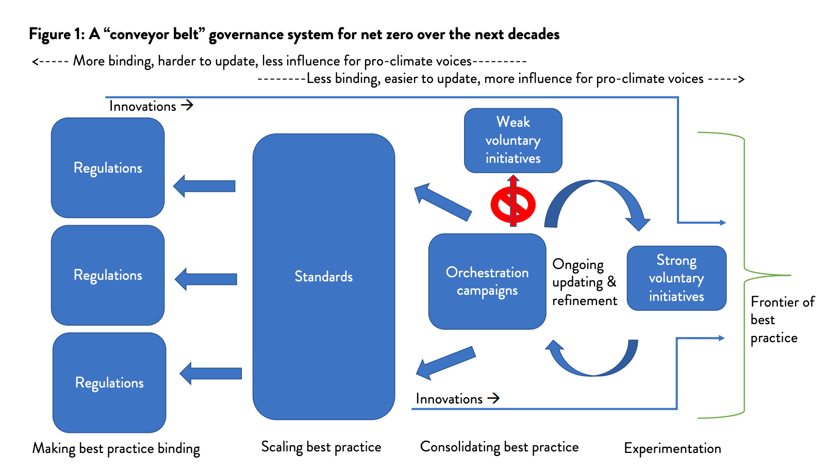
A Governance Conveyor Belt for Net Zero Policy
Source: Hale, 2022
Net Zero Conveyor Belt Policy Memo
Notes:
Source: Governing net zero conveyor belt
https://kleinmanenergy.upenn.edu/wp-content/uploads/2022/12/KCEP-Net-Zero-Governance-Conveyor-Belt.pdf

Slide 13
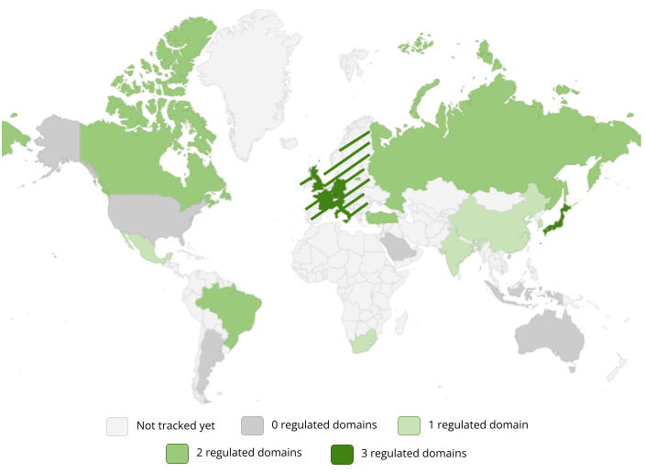
Net zero regulations

Slide 14
Looking Ahead: Economies Converging on Key Elements
Disclosures
Companies and financial institutions report on risk of climate impacts.
Transition plans
Firms outline their pathways to net zero to create transparency.
Claims
Net zero and carbon neutral related claims are subject to regulation.
Product standards
Products (like carbon offsets) are regulated and standardised.
Procurement requirements
Governments contract to firms that meet net zero
International trade
Standardising green products enables international trade & investment.
Adapted from: R2Z Pivot Point Report

Slide 15
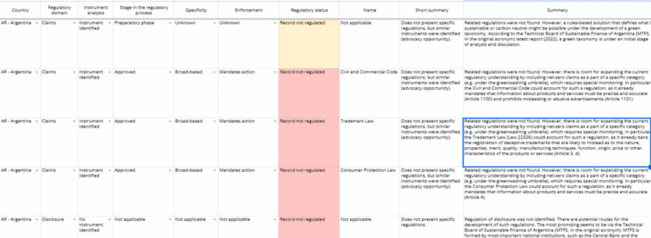
Net Zero Regulation Tracker
Maps the development of regulations in G20 members, covering net zero-related claims, disclosure of climate-related risks, decarbonization-focused procurement, and transition plan requirements.
+390 instruments tracked so far.
Notes:
ISO: More than 1,200 experts from over 100 countries contributed to make an effective common reference for net zero guidance.
HLEG: UN’s High Level Expert Group Net Zero Report
Recommendations to ensure integrity of net zero commitments by businesses, financial Institutions, cities and regions
Group of 18 diverse experts with expertise in preventing greenwashing

Slide 16
Regulatory trends at the national level
11 x growth
Notes:
ISO: More than 1,200 experts from over 100 countries contributed to make an effective common reference for net zero guidance.
HLEG: UN’s High Level Expert Group Net Zero Report
Recommendations to ensure integrity of net zero commitments by businesses, financial Institutions, cities and regions
Group of 18 diverse experts with expertise in preventing greenwashing

Slide 17
Regulatory trends at the national level
Notes:
ISO: More than 1,200 experts from over 100 countries contributed to make an effective common reference for net zero guidance.
HLEG: UN’s High Level Expert Group Net Zero Report
Recommendations to ensure integrity of net zero commitments by businesses, financial Institutions, cities and regions
Group of 18 diverse experts with expertise in preventing greenwashing

Slide 18
In progress US national level regulations
Claims
Authority: Securities and Exchange Commission (SEC)
Proposal content:
Requires funds with certain names, including ESG-related, to invest at least 80% of their assets in investments that support their claimed goals.
Bans funds that don’t invest the 80% min. to use ESG-related names.
Net zero claims are cited as examples and might be specifically regulated in the final version.
Disclosure
Authority: Securities and Exchange Commission (SEC)
Proposal content:
Requires issuers of securities to disclose:
  Climate-related risks and their materiality on the business and strategy
  Scope 1 and 2 GHG emissions
  Scope 3 emissions if material and the issuer is not small
  Target, goals, and non-mandatory transition plans
Procurement
Authority: Federal Acquisition Regulator (FAR)
Proposal content:
Requires major federal suppliers (> USD 50 mi in contracts/year) to
Disclose GHG emissions and climate-related risks
Set science-based reduction targets
Contractors who fail to complete their disclosure obligations are considered "nonresponsible“, which conditions procurement to companies that meet well-defined net zero standards
Requires major federal procurements to
Include social cost of emissions in decisions
Where, possible, give preference to bids with the overall lowest cost
Notes:
ISO: More than 1,200 experts from over 100 countries contributed to make an effective common reference for net zero guidance.
HLEG: UN’s High Level Expert Group Net Zero Report
Recommendations to ensure integrity of net zero commitments by businesses, financial Institutions, cities and regions
Group of 18 diverse experts with expertise in preventing greenwashing

Slide 19
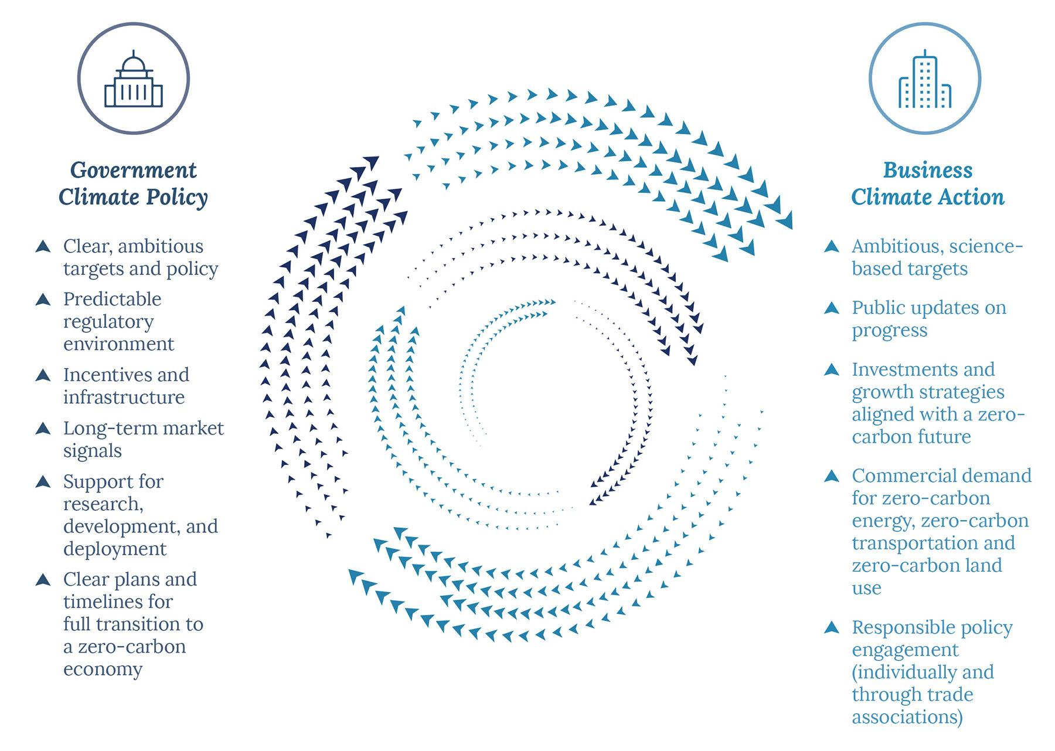
Cause for Hope? The Ambition-Action Loop
Or cause for hope? Is there an Ambition Loop?
Innovation
Low-carbon solutions could be competitive in 75% of sectors by 2030, compared to zero in 2015.
Low-carbon growth this decade will generate over 35 million jobs.
(Systemiq, 2020)
The Ambition Loop paper is produced by We Mean Business, the World Resources Institute and UN Global Compact ambitionloop.org
Notes:
as Systemiq’s 2020 report makes clear. Low-carbon solutions could be competitive in 75 percent of sectors by 2030, compared to zero in 2015 and low-carbon growth this decade will generate over 35 million jobs. California’s Right to Repair Bill that was recently backed by Apple in a press release is a good example of the ambition loop in action.

Slide 20

US Examples coming from local and regional govt
MA: Stretch energy and municipal opt-in
3-stringency building energy code.
The most stringent code (the “Stretch code”) has been adopted by 300 MA municipalities.
The Stretch Code is aligned with the State 2050 net-zero goal and is valid for new constructions.
Buildings switch from fossil fuel heating and cooking to electrical services + PV installation.
CA: Advanced Clean Cars II
New passenger cars, trucks and SUVs sold in California to be “net zero” by 2035, with emissions reductions from 2026.
“Net zero vehicles” are electric vehicles, hybrid, and hydrogen-powered vehicles, but 45% of CA’s electricity comes from fossil fuels.
Likely to affect multiple other states that make use of California’s vehicle regulations.
LA: Climate action plan
Transition plan to reach short (-26-28% by 2025), medium (-40-50% by 2030) and long-term transition goals (net zero by 2050).
Just Transition for oil and gas workers to job placements in clean energy
Collaboration with local government climate planning to promote convergence of actions
Map Source: Openclipart.org

Slide 21
US Examples coming from local and regional govt
National-level policy and regulations
State-level policy and regulations
What are examples that you know about?
Municipal-level policy and regulations
Procurement
Zero emission zones
Clean air rules
Building regulations
Electricity mandates
Fossil fuel bans
Deforestation regulation

Slide 22
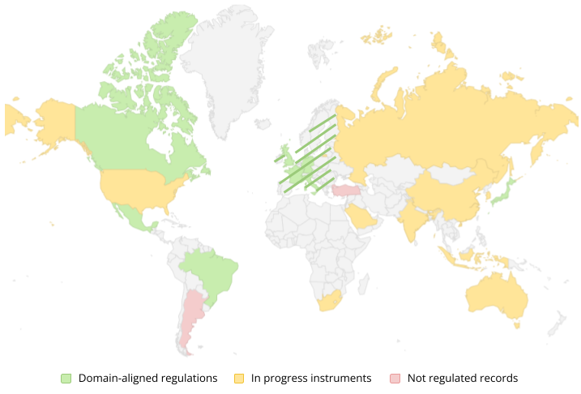
Science to Policy Success Case: Mandatory Disclosure
Mandatory disclosure now covers 29% 2022 GDP and could reach 83%
Regulation Tracker, Oxford Net Zero (2023)
Notes:
Map shows following countries that have mandatory disclosure: Australia, Canada, China, EU, Hong Kong, India, Japan, Malaysia, New Zealand, Singapore, South Korea
Some countries are going even further:
France, UK, US, EU have specific requirements for making claims
EU, UK, US have procurement and product standards
China, France, Spain and UK have requirements surrounding transition plans.

Slide 23

Stemming backlash to climate interventions
Tips for effective and sustainable interventions that receive positive public response
How:
  Policy design matters
  Carrot or stick?
  Address mistrust around climate interventions
Participants at a citizens’ assembly, Los Angeles © Berggruen Institute
Notes:
These tips draw on evidence from academic research, think tanks and learning from existing examples of climate interventions.
How:
Policy design – learnings especially relating to congestion charging demonstrate that policy design is crucial to driving acceptance. For example, this includes clarity around how proceeds/taxes will be earmarked for other projects (e.g., in NY for improving the subway system), how low-income households or businesses will be compensated/given exemptions, Baranzini et al 2021; Carattini et al
Carrot v Stick : Survey of Americans in 2013 demonstrated voters tend to prefer subsidies and tax rebates over carbon taxes (Leiserowitz et al (2013), Alberini et al 2016, ). Norway demonstrates that national policies to incentivise EV purchases led to BEVs making up 80% of the market share pf car sales between May 2022-23. https://insideevs.com/news/670561/norway-bev-sales-may-2023/ , https://elbil.no/english/norwegian-ev-policy/. Acknowledge the cost alongside benefits of climate interventions – i.e., that reaching net zero will create discomfort within a carbon-dependent society, but there is a clear plan on how to mitigate these challenges.
Addressing mistrust in climate interventions often involves addressing underlying mistrust in government/governance structures. Evidence from Ireland, historically a ‘climate laggard’ in the European context, demonstrates the value added by novel engagement techniques. There, policy-makers used ‘citizens assemblies’ to deliver recommendations to the Irish Parliament on climate policy interventions. The principle of citizens assemblies is that you bring together a group of individuals representative of your jurisdictional demographics, and have them discuss and evaluate different policy proposals with experts and non-experts. These sessions are typically run over several weekends, and are intended to result in consensus that is reflective of broader values within the wider population. In Ireland, two of three radical recommendations were adopted by the parliament – to increase renewable energy from 30-70% of supply, and increasing the price of carbon from 20-80 euro per tonne, both by 2030. This approach hasn’t yet taken off in the USA in the same way it has in Europe, but cities are beginning to experiment with this form of public engagement, for example, in late 2022, Los Angeles trialled used this method to discuss the future of a public space in Petaluma. Lala Muradova, Hayley Walker & Francesca Colli (2020)

Slide 24
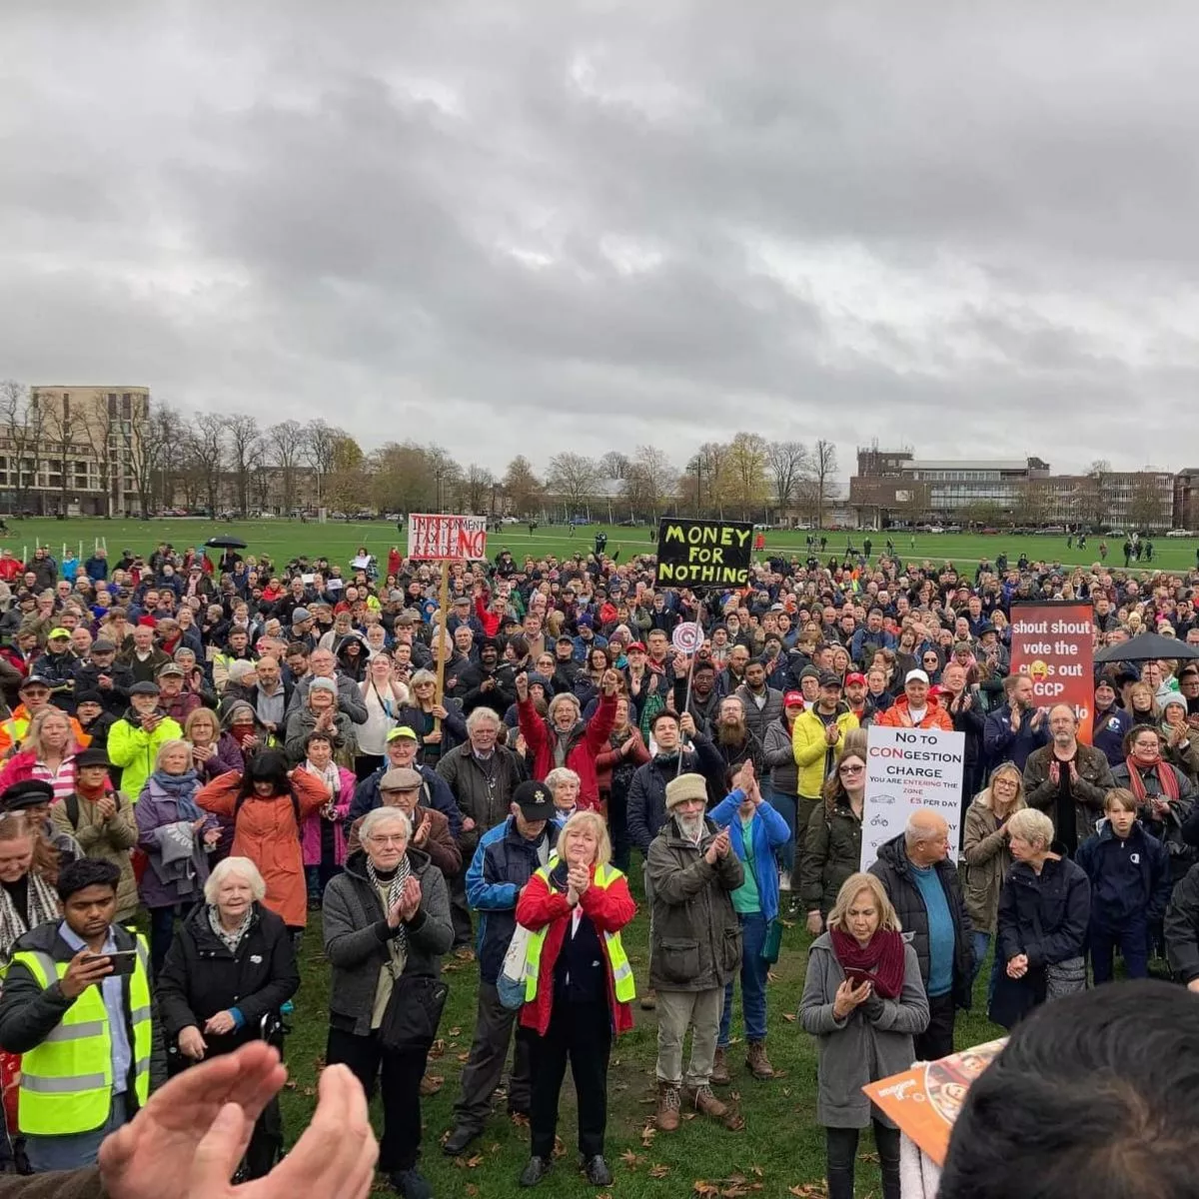
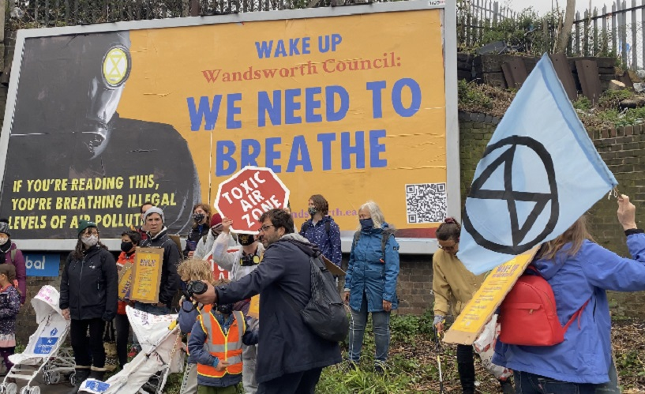
Stemming backlash to climate interventions
What:
  Putting the focus on climate change alone can turn some people off
  What are the co-benefits of an intervention that are also important to a community?
  What/who can the policy be placed in coalition with?
Protests in support of action against air pollution in London, and against the proposed congestion charge in Cambridge
Notes:
What:
Preliminary results from a representative survey of 4100 residents in Berlin and Paris demonstrated that framing of policy interventions is important: Reducing air pollution was a greater motivating factor for generating support in congestion charging policies in those cities than was climate change impacts or travel time savings. Build also on American’s desire to have environmental protections – consider how interventions for e.g., improved water quality might also have climate impacts.
This also presents the opportunity to coalition build: https://iopscience.iop.org/article/10.1088/1748-9326/ab81c1/meta . Bergquist in a survey of 400 representative Americans demonstrated that this was a particularly useful strategy amongst people of colour. Historically, a major example of successful use of coalitions is in the Netherlands during the 1970s, where groups advocating for child road safety and neighbourhood preservation became pivotal in strict road rules for drivers in Dutch cities. As a result, the driving boom was replaced by a cycle boom. However, climate didn’t feature in these conversations – it came down to road safety, neighbourhood integrity and community cohesion (which was being disrupted by car-centric redevelopments).

Slide 25
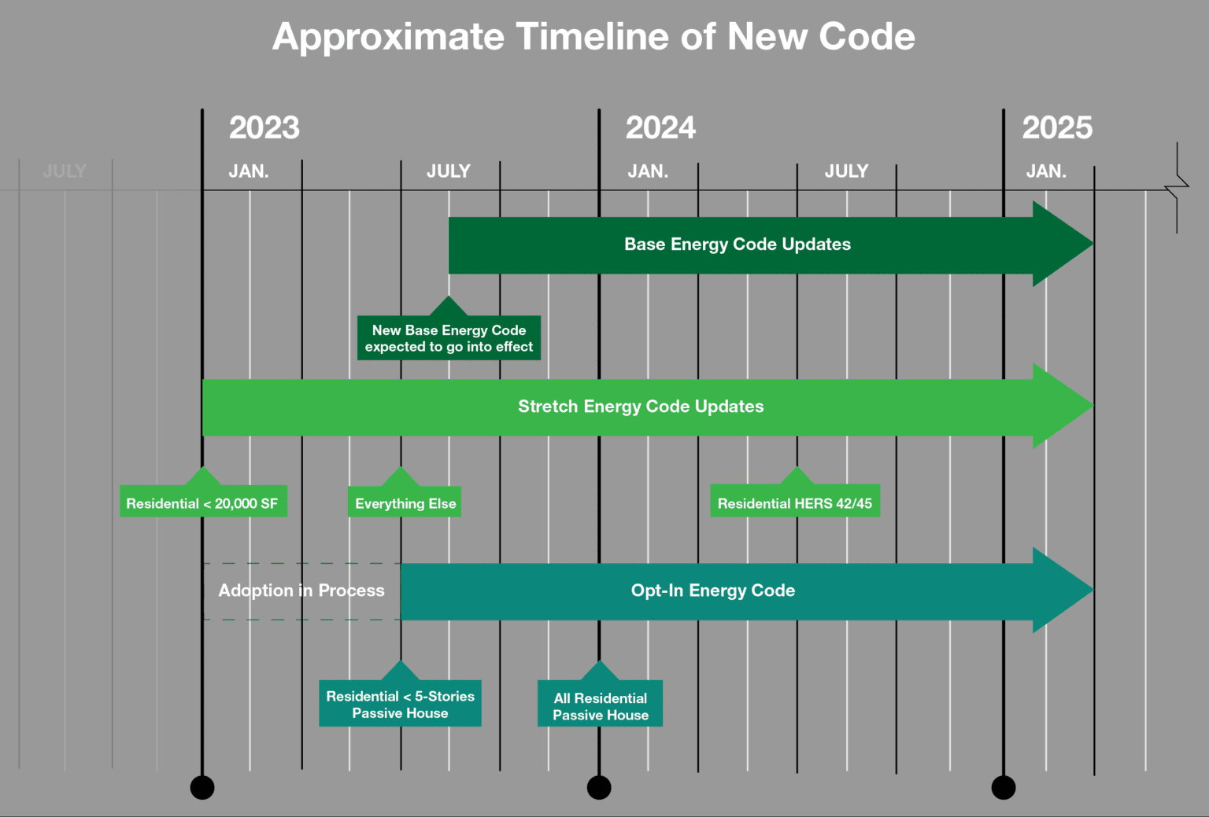


Stemming backlash to climate interventions
When:
  Consider the value of trial periods to implement radical policies
  Ensure there are clear, achievable timelines with meaningful wrap-around support and guidance to accompany people on the transformation journey
Notes:
When
Trial periods have been valuable in European cities for generating public support for congestion charging schemes. In 2011 in Milan, after a trial period, 79% of voters approved the extension of the congestion charging policy. Similar evidence has emerged from Stockholm in Sweden (Schuitema et al 2010). In Switzerland in relation to waste policies, after a trial period residents were willing to accept a 70% higher price for waste disposal than prior, once realising benefits (Carattini et al 2018). Although it doesn’t eliminate opposition to policies, it greatly reduces it. This because it gives voters time to experience the positives of these interventions, which they may previously not have recognised/thought they would benefit from.
Timelines, guidance, support.
There’s ambitions to adjust building regulations to force builders and developers meet net zero targets
Findings from workshops with architects, developers and local authorities in the UK outlined some ways that regulations can be more easily adopted. This workshop was in relation to net zero buildings, but findings can be applied to other sectors:
Announce key decisions and changes to regulations early
Provide consistent and stable versions of measurement techniques
Hold engagement between responsible jurisdictional bodies and those bodies who will be implementing/working with these regulations, to share learning and improve communication between different groups
From: Ehwi et al 2023 (Delivery of net zero housing: the role of planning)

Slide 26


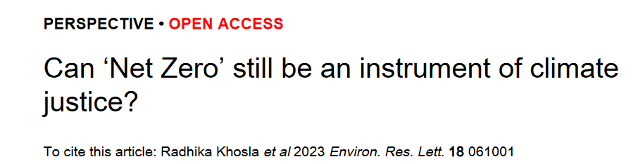
Stemming backlash to climate interventions
  Who:
  Who bears the biggest brunt of your plans – consider the climate justice implications of any interventions
  Who can benefit from any support you might give?
Notes:
Who
Opposition to climate mitigation policies is often on grounds of inequality – whether spatial, income, or race. World Bank 2022 https://documents1.worldbank.org/curated/en/099435009192218701/pdf/IDU064cb89c9021ad048e20bd5a0c2f0100dbc7e.pdf The risk of adverse impacts on inequality as carbon mitigation strategies expand is increasing, therefore there needs to be careful planning and management of interventions with a pro-poor approach that simultaneously reduces inequalities and helps mitigate climate change.
Study from California showed that household PV incentives had much lower uptake from disadvantaged householders, therefore important to consider how incentive policies impact/can benefit different demographics. What extra things need to be put in place to make the benefits of schemes widely available and accessible, to prevent deeper entrenchment of inequalities https://www.sciencedirect.com/science/article/abs/pii/S0301421519305221

Slide 27
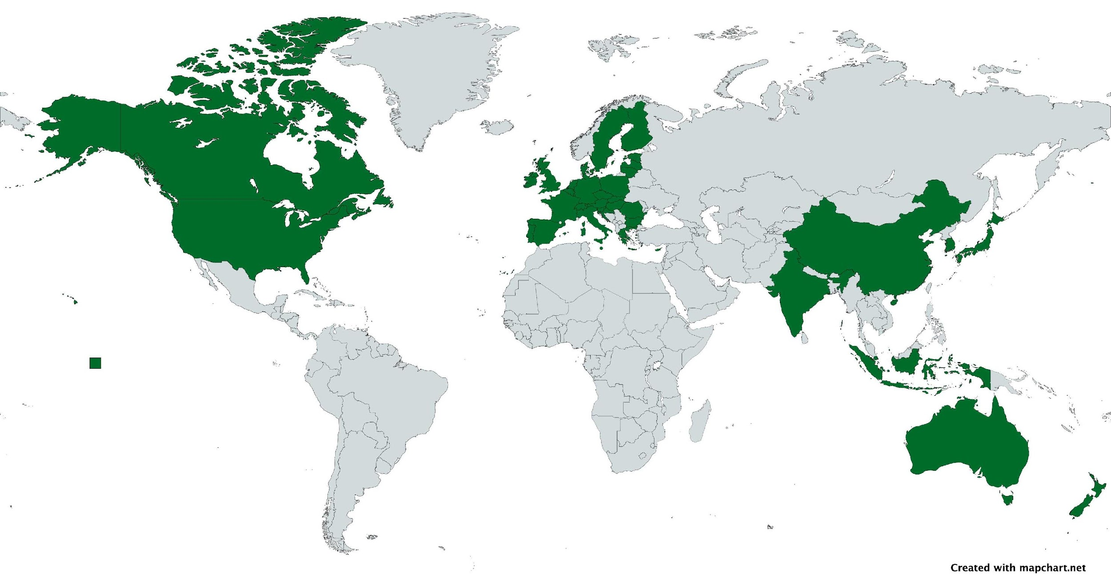
Science to Policy Success Case: Mandatory Disclosure 🡪 If we’re using this slide, I suggest we use the Tracker’s map instead (available on the next slide)
Mandatory disclosure now covers 47.9% 2021 GDP
46.6% 2019 emissions
Adapted from: R2Z Pivot Point Report
Notes:
Map shows following countries that have mandatory disclosure: Australia, Canada, China, EU, Hong Kong, India, Japan, Malaysia, New Zealand, Singapore, South Korea
Some countries are going even further:
France, UK, US, EU have specific requirements for making claims
EU, UK, US have procurement and product standards
China, France, Spain and UK have requirements surrounding transition plans.

Slide 28
Summary: The Evolution of Net Zero from Science to Practice
START
ESTABLISH SCIENCE OF
NET ZERO
2008-2015
  Scientists establish the global understanding of net zero and the impact of cumulative emissions.
AGREE TO GLOBAL
NET ZERO
2015-2021
  International paris agreement acknowledges this balance
  Governments & organisations increasingly set net zero targets
  Race to Zero Launches
  Initiatives emerge to provide detailed guidance for national and subnational net zero close greenwashing loopholes / the gap between science and practice,
DEFINE NET ZERO FOR SUBNATIONAL
2021-2022
  SBTi, HLEG, Race to Zero & ISO standards
SCALE NET ZERO STANDARDS AND POLICY
2023-2025
  Governments & standards close loopholes
  The age of implementation begins through wide scaling of these standards and guidance
IMPLIMENT NET ZERO
2025-2050
  Implementation phase
  Guidance is tested and iterated, finds its way into policy.
ACHIEVE NET ZERO
2050-
  Net zero achieved and maintained
GOAL
Notes:
New standards and phase of going into the future.

Slide 29
Net zero resources
Essential net zero information
Policy and Regulation Tracker
US Climate Alliance – Climate Policy Database
Race to Zero – Global orchestration campaign for net zero commitments
  Lexicon
  Criteria
Race to Zero Cities Network
SBTi – Only standards for target setting
HLEG Integrity Matters Report
ISO Net Zero Guidelines – Best practice develop through consensus process
Net Zero Tracker
Climate Policy Resources Broadly – And Partners We Work With
Grantham Climate Policy Database
Climate Policy Radar
GCAP – Global Climate Action Portal
Apolitical
Notes:
New standards and phase of going into the future.

Slide 30
References
Alberini, A., Scasny, M., & Bigano, A. (2016). Policy vs individual heterogeneity in the benefits of climate change mitigation: Evidence from a stated-preference survey (FEEM Working Paper No. 80.2016). Milan, Italy: FEEM
Baranziniet al 2021. "Designing effective and acceptable road pricing schemes: evidence from the geneva congestion charge." Environmental and resource economics 79, no. 3: 417-482.
Bergquist, et al 2020. "Combining climate, economic, and social policy builds public support for climate action in the US." Environmental Research Letters 15, no. 5: 054019.
Carattini et al 2018. "Is taxing waste a waste of time? Evidence from a supreme court decision." Ecological Economics 148 : 131-151.
Ehwi et al 2023, “Delivering Net Zero Carbon Housing: The Role of Planning”. Cambridge Centre for Housing and Planning Research
Inside Evs (2023) “Norway BEV Sales: Over 80% Of New Cars Were All-Electric In May 2023”
Leiserowitz et al (2013). “Public support for climate and energy policies in November 2013”, Yale University and George Mason University. New Haven, CT: Yale Project on Climate Change Communication.
Liotta et al 2022, “Climate Policy and Inequality in Urban Areas”. Policy Research Working Paper, 10185, World Bank
Lukanov, et al 2019. "Distributed solar and environmental justice: Exploring the demographic and socio-economic trends of residential PV adoption in California." Energy Policy 134 : 110935.
Muradova, et al 2020. "Climate change communication and public engagement in interpersonal deliberative settings: Evidence from the Irish citizens’ assembly." Climate Policy 20, no. 10: 1322-1335.
Norwegian EV Association (2023) Norwegian EV policy
Pew Research Centre 2023. What the data says about Americans’ views of climate change
Schuitema, et al 2010. "Explaining differences in acceptability before and acceptance after the implementation of a congestion charge in Stockholm." Transportation Research Part A: Policy and Practice 44, no. 2 : 99-109.

