Slide 1

Building an AI-Ready Government
The SSA - A Practical Framework for Responsible AI Integration
Cha'Von K. Clarke-Joell
Co-Founder & Chief Disruption Officer, The TLC Group of Companies
Founder & Principal Consultant, CKC Cares

Slide 2



Acknowledgments
Premier Alan Winde, Western Cape Government
Cori Zarek, VP, North America, Apolitical
Aneesa Basha, Acting Chief Director, Centre for e-Innovation
Moderator: Jesse Samasuwo, Policy and Insights Senior Manager, Apolitical
To everyone on the call: Thanks for joining this session.
Hello from the petit island of Bermuda by way of London!

Slide 3
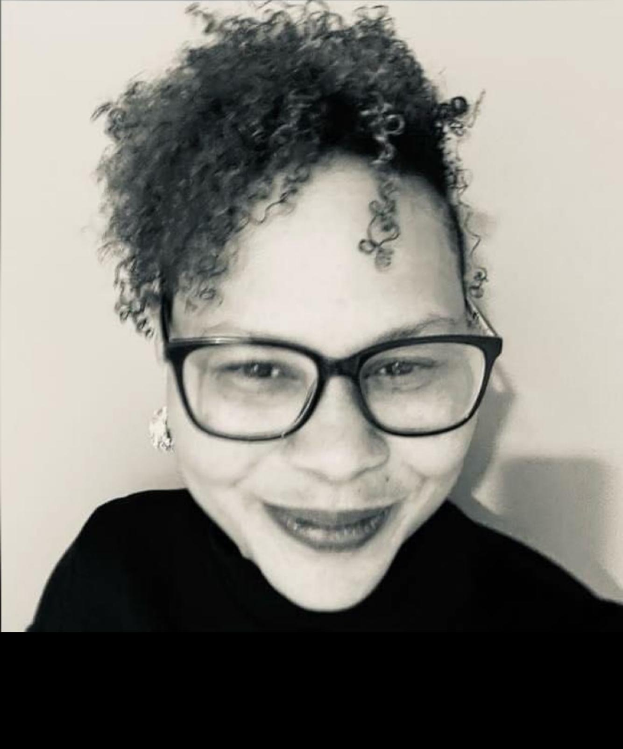
Cha’Von Clarke-Joell (CJ)
Data Protection Advocate, Coach, Playwright, Poet, Author, AI Ethicist, Educator, Entrepreneur
Bermuda Roots, Global Impact: Born in Bermuda, Sierra Leone & Ethiopian familial connections
Storyteller & Ethicist: Playwright, author & poet, blending creativity, ethics, and leadership globally.
Academic Prowess: Psychology, Cognitive Neuroscience & Criminal Justice; Advanced degrees in Playwriting and Leadership, with certifications in AI Ethics, Data Privacy, Cybersecurity, Business, Gen AI and Prompt Engineering.
Global Speaker, Advocate & Consultant: Keynote at the Nation Digital Summit in Kenya, World AI Summit in Amsterdam, DisruptHR in Bermuda, Women in AI Africa (WAIA), Mission Impact Academy (Mia AI), and MK AI Summit in Milton Keynes. Guest lecturer at international universities on AI ethics and governance​.
Former Assistant Commissioner (Bermuda): Led innovation, policy, and engagement for AI ethics and privacy at the Office of the Privacy Commissioner, spearheading community initiatives like “Privacy Hour for Students” and “Senior Privacy Tea”
Mentor, Coach, Advisor: Supporting ethical AI, blockchain innovation (India Blockchain Alliance), leadership development, and data-driven education for Bermuda Signature Learning Schools.
Educator: Developed AI curricula & tailored data protection/security certifications, and Associate Lecturer (MSc), inspiring the next generation of leaders. Ad-hoc AI SME at McGraw Hill Publishing; guest lecturer for NOUN-Notre Dame Online Training Course and Research Project on Ethics and Sustainability of Artificial Intelligence for Nigerian Higher Education Lecturers; IAPP AIGP, CIPT & CIPM certification exam writing
Entrepreneurial Passions: Founder of CKC Cares and co-Founder & Chief Disruption Officer for The TLC Group of Companies, championing ethical, human-first AI solutions, digital wellbeing & resilience.
Values: Creativity, BSJ, diversity, empowerment, and..."Human at the core, AI to explore!"

Slide 4





Building an AI-Confident Culture
People-First
Responsible AI adoption relies on empowering teams and individuals, not just tools
Sense Disruption
Build AI governance with cultural understanding and transparency to reduce fear
Shape Thought-Leaders
Belonging—engage diverse voices, design for equity, shape human-centric solutions.
Adapt to Achieve
Encourage learning, embrace innovation, empower local & global communities.

Slide 5
Key Challenges in AI Implementation
Global Data Privacy
Ethics & Bias
Talent & Infrastructure
Upholding trust and comply with laws (e.g., POPIA, GDPR, etc.)
Shaping fair, inclusive, and meaningful AI that serves all groups and communities
Overcoming talent gaps and legacy systems; cultural & digital comfort differences; the BYOAI phenomena

Slide 6




Opportunities Through AI
Service Enhancement
AI can be designed to anticipate citizen needs to improve services.
Data-Driven Policy
Shape informed policies with data insights through AI and ML.
Crisis Response
AI-powered predictions can inform rapid emergency or strategic actions.

Slide 7


Sense, Shape, Adapt Framework for AI Governance & Leadership
1
Sense for Strategy
Align AI with public good and ethical commitments
2
Shape for People & Skills
Build an ethically aware, multi-skilled workforce, BYOAI
3
Align for Governance
Implement accountable frameworks aligned with consideration fo
the cultural differences of each region

Slide 8
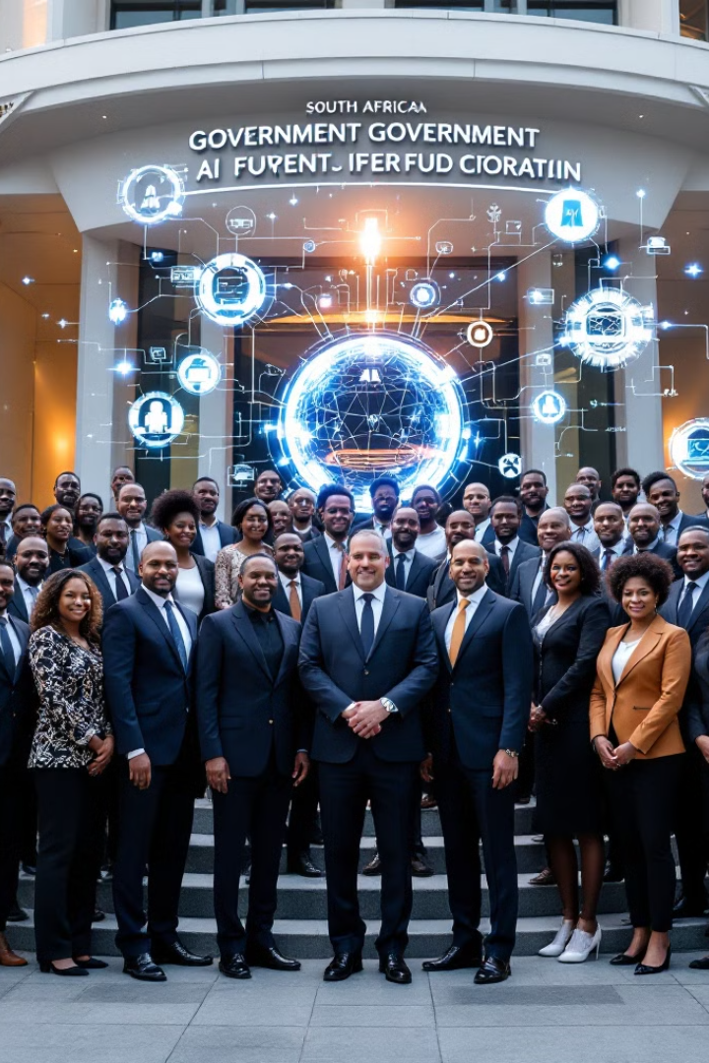
Conclusion
Takeaway
An AI-ready government thrives on clarity, inclusion, adaptability,
and resilience in the digital polycrisis
Closing Thought
Lead AI and digital transformation with equity, transparency,
culture & human-focused dedication to public trust

Slide 9

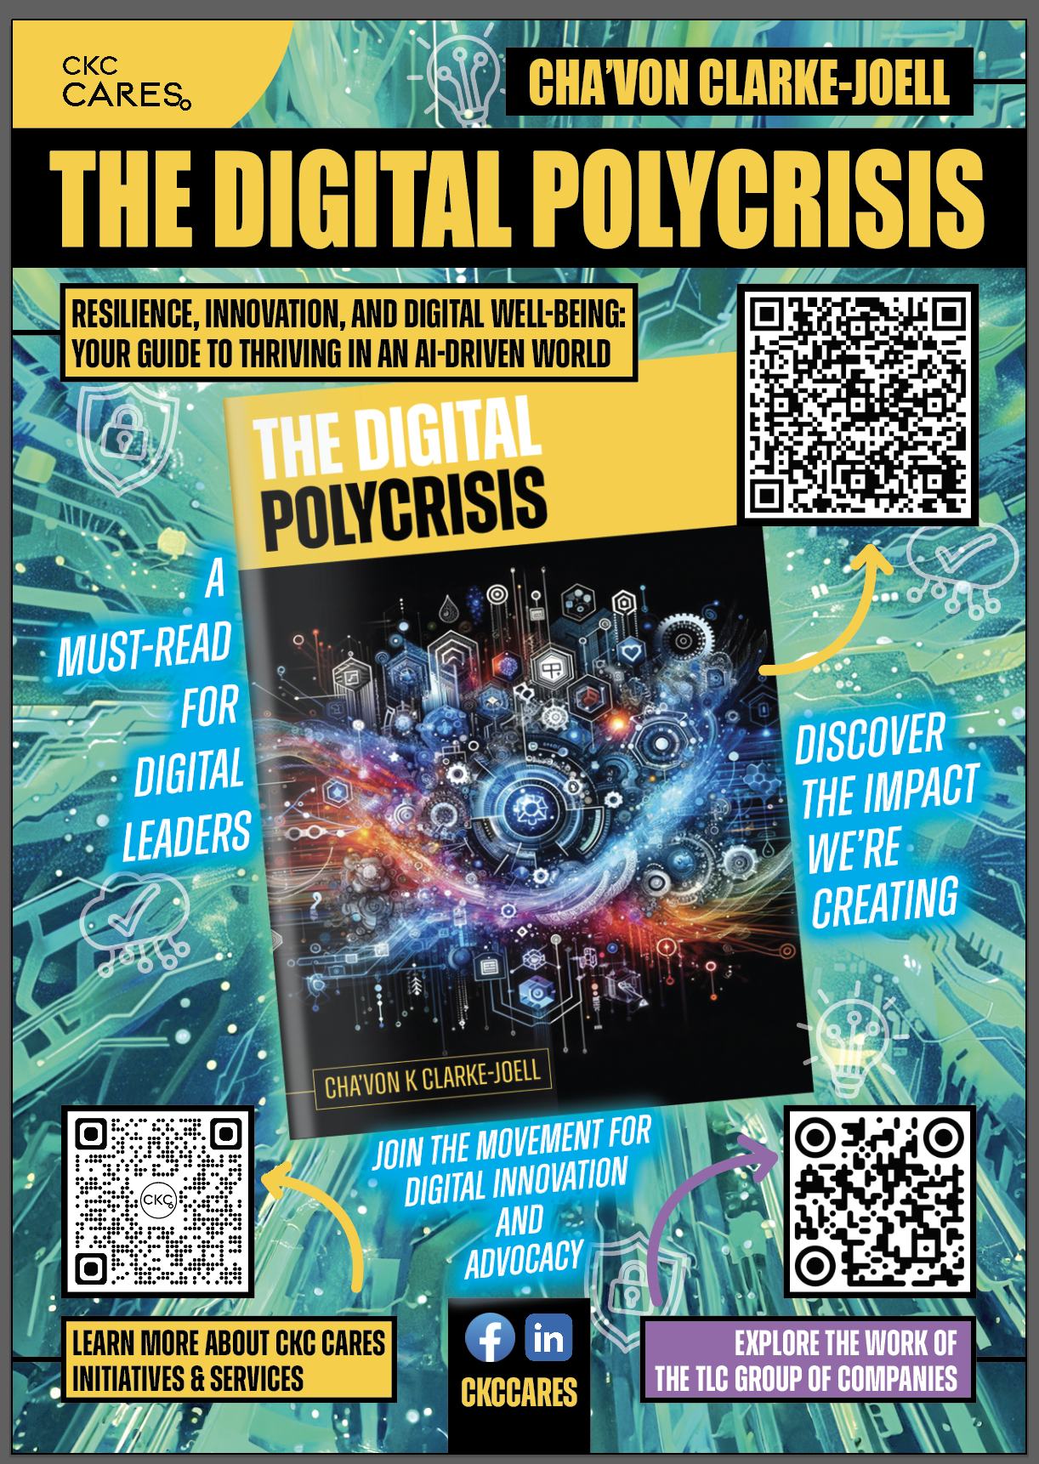
Final Thoughts: Thriving in the “Age of AI”
www.ckccares.com
www.thetlcgroup.pro
engagement@ckccares.com
solutions@thetlcgroup.pro
Embrace Change
View AI and digital transformation as an opportunity for strategic growth and innovation.
Collaborative Approach
Foster collaboration within communities, teams and external partners to tackle complex challenges.
Be Kind to Yourself
Remember, building resilience is an ongoing process.
linkedin.com/in/chavonjoell
Disclaimer: All images in this presentation were generated by AI and may or may not reflect real people, places, or events. They are used for illustrative purposes only.

